Slide 1

  Chapter Four
  Physical and Data link layer

Slide 2

Chapter Outline
  Physical Layer
  Coding and Multiplexing
  Data link layer overview
  Flow and error control
  Medium access control
  Local area networks [Types, Protocols, Performance]
  Wireless Networks
  Switching, Bridging and VLANs
  WAN[Packet switched data network, Circuit switched data networks,
  ISDN, Private networks
  Internet data link control protocols: PPP and HDLC

Slide 3
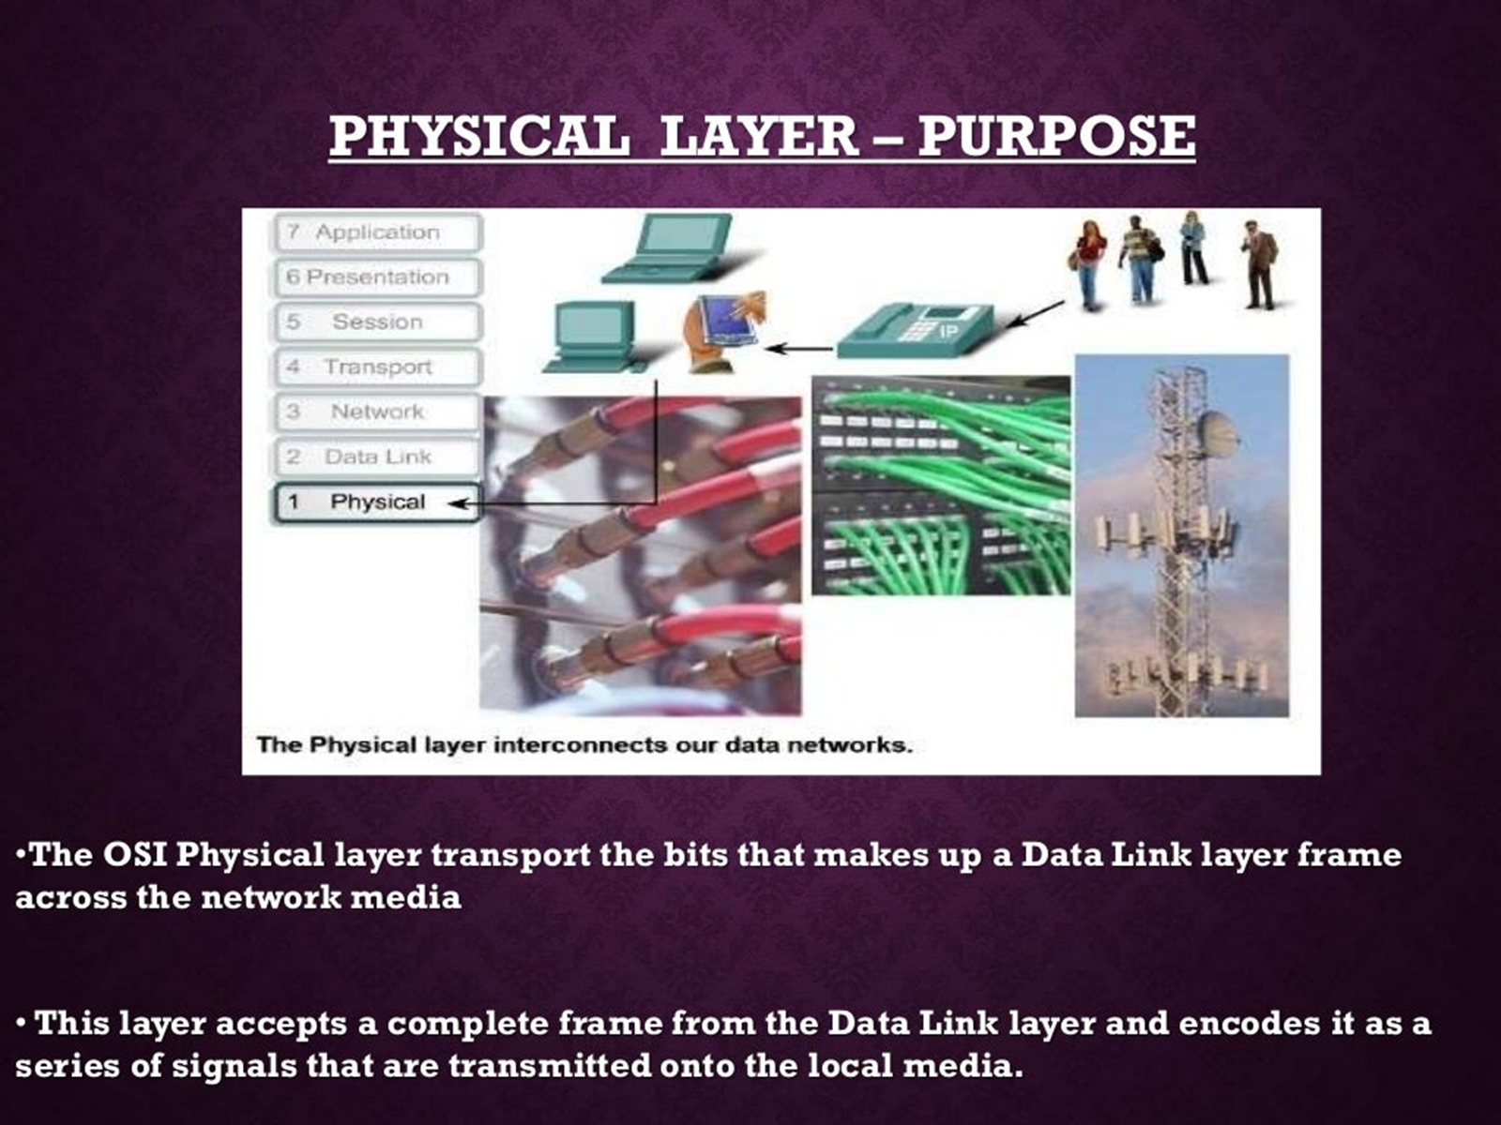
Cntd…

Slide 4
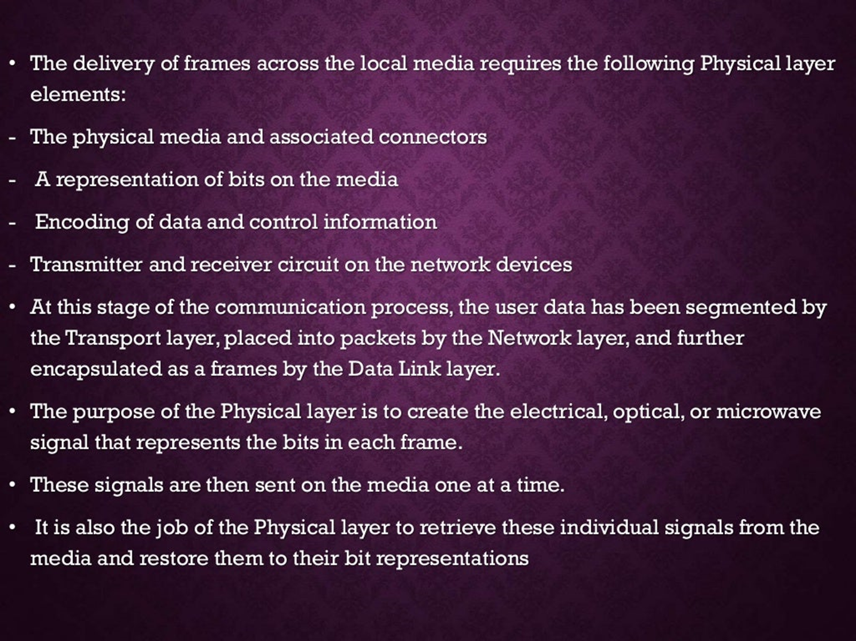
Cntd…

Slide 5
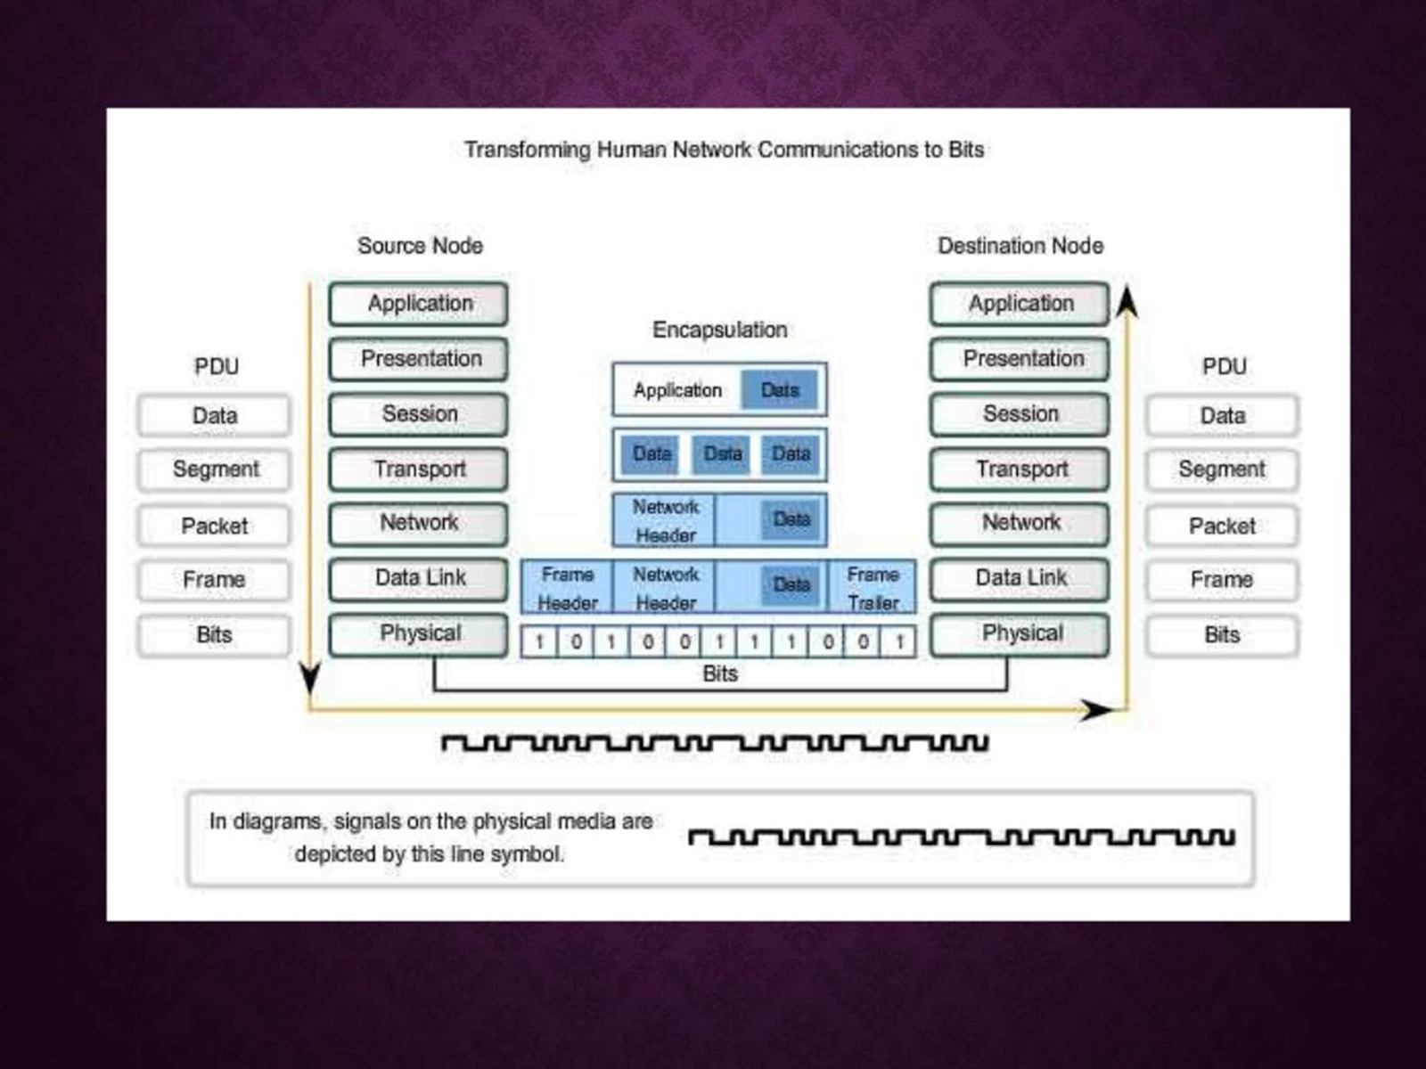
Cntd…

Slide 6
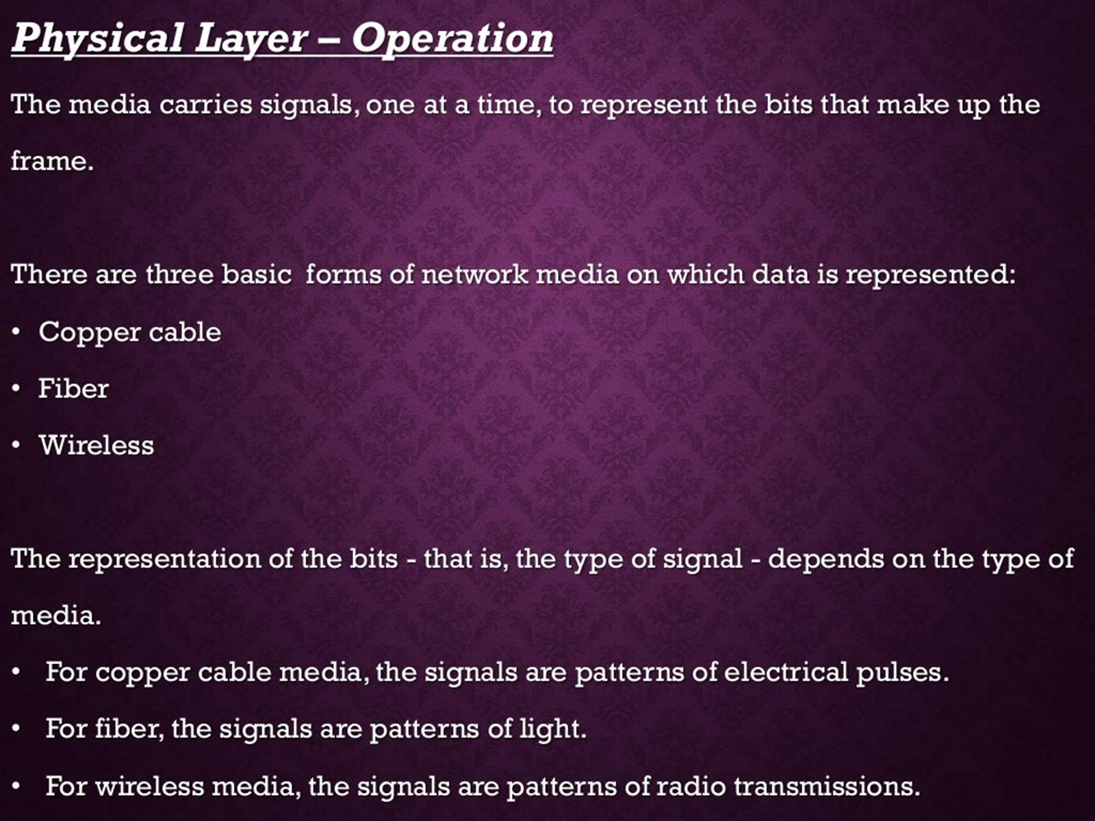
Cntd…

Slide 7
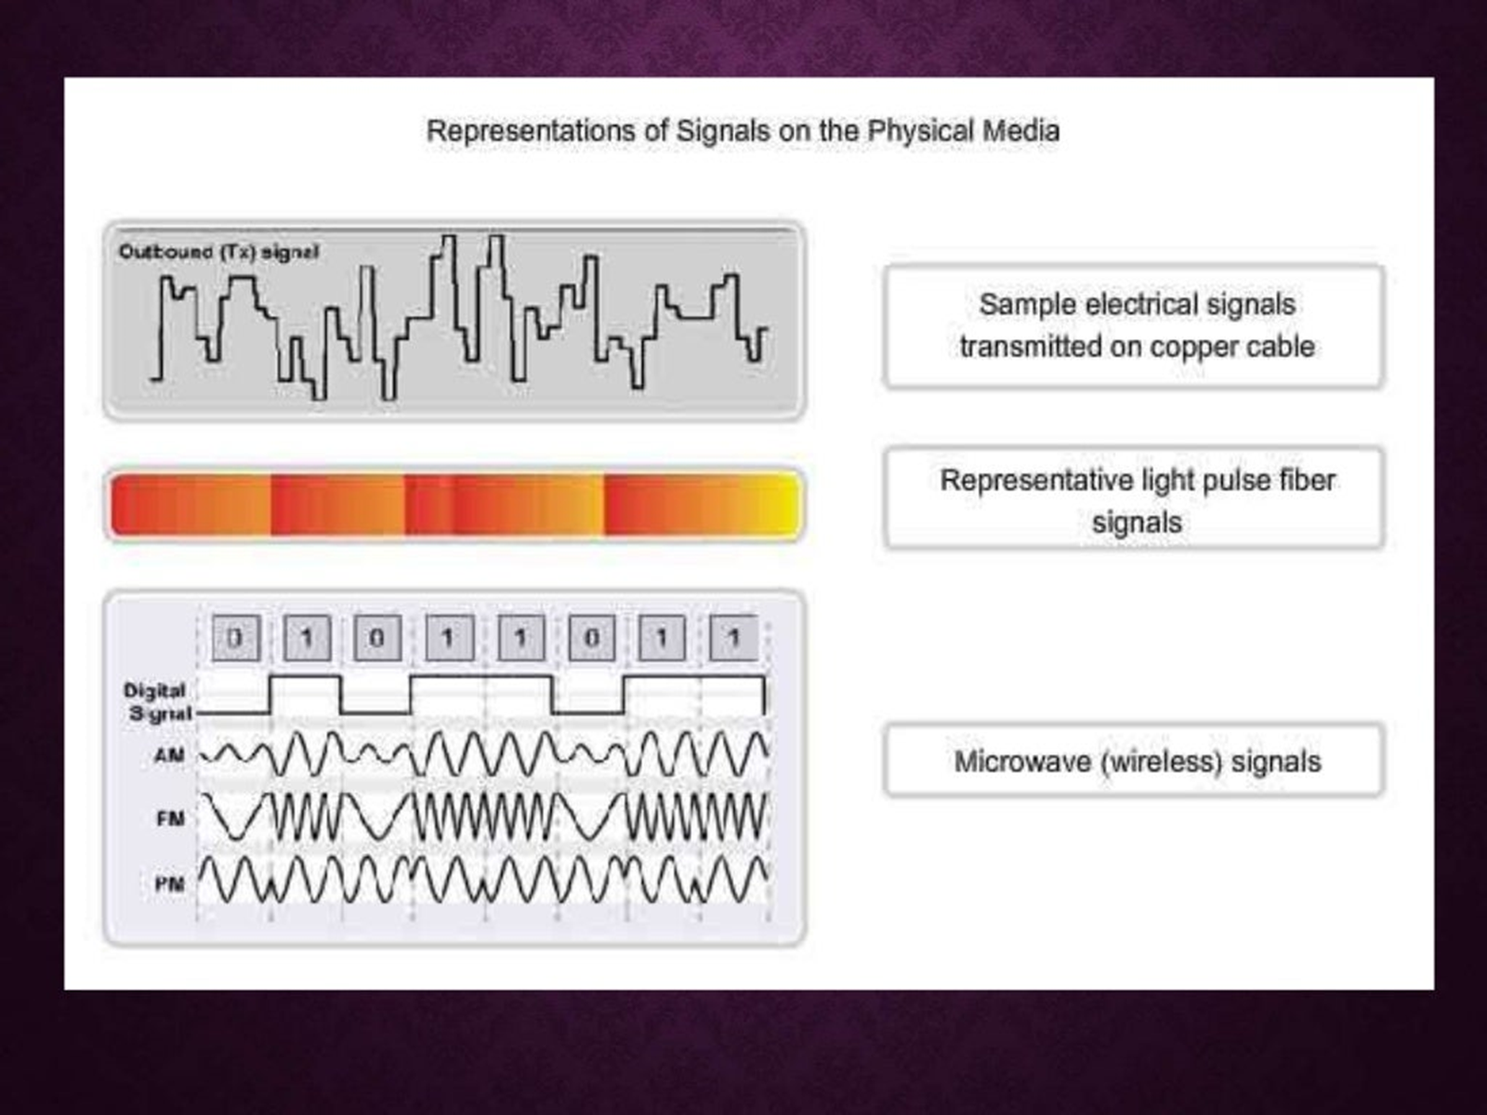
Cntd…

Slide 8
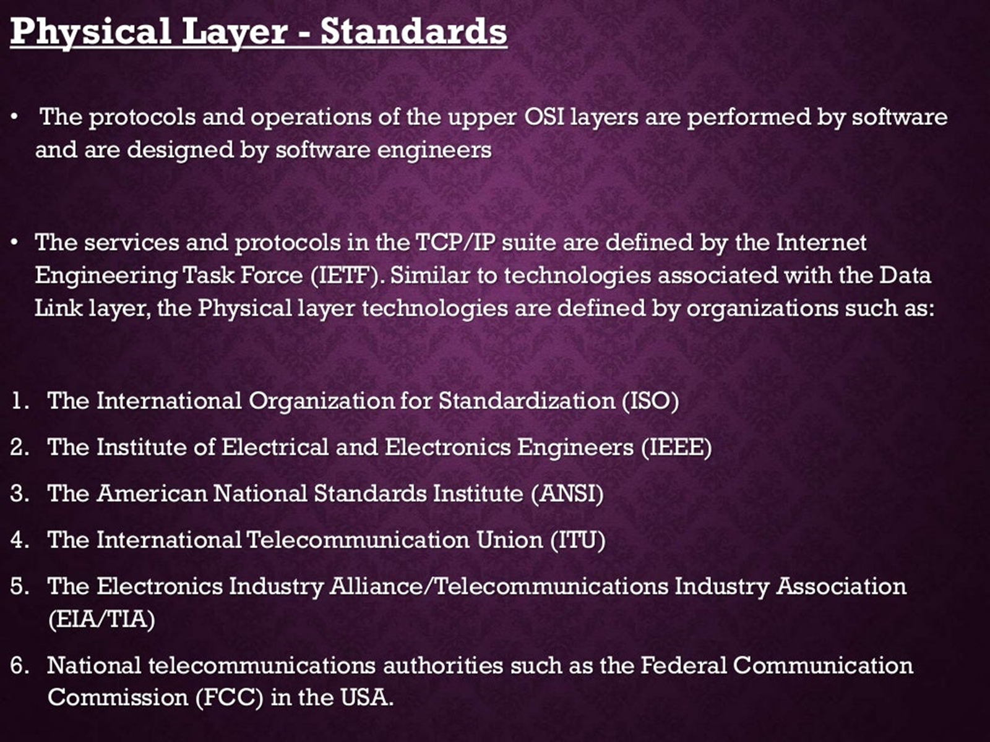
Cntd…

Slide 9
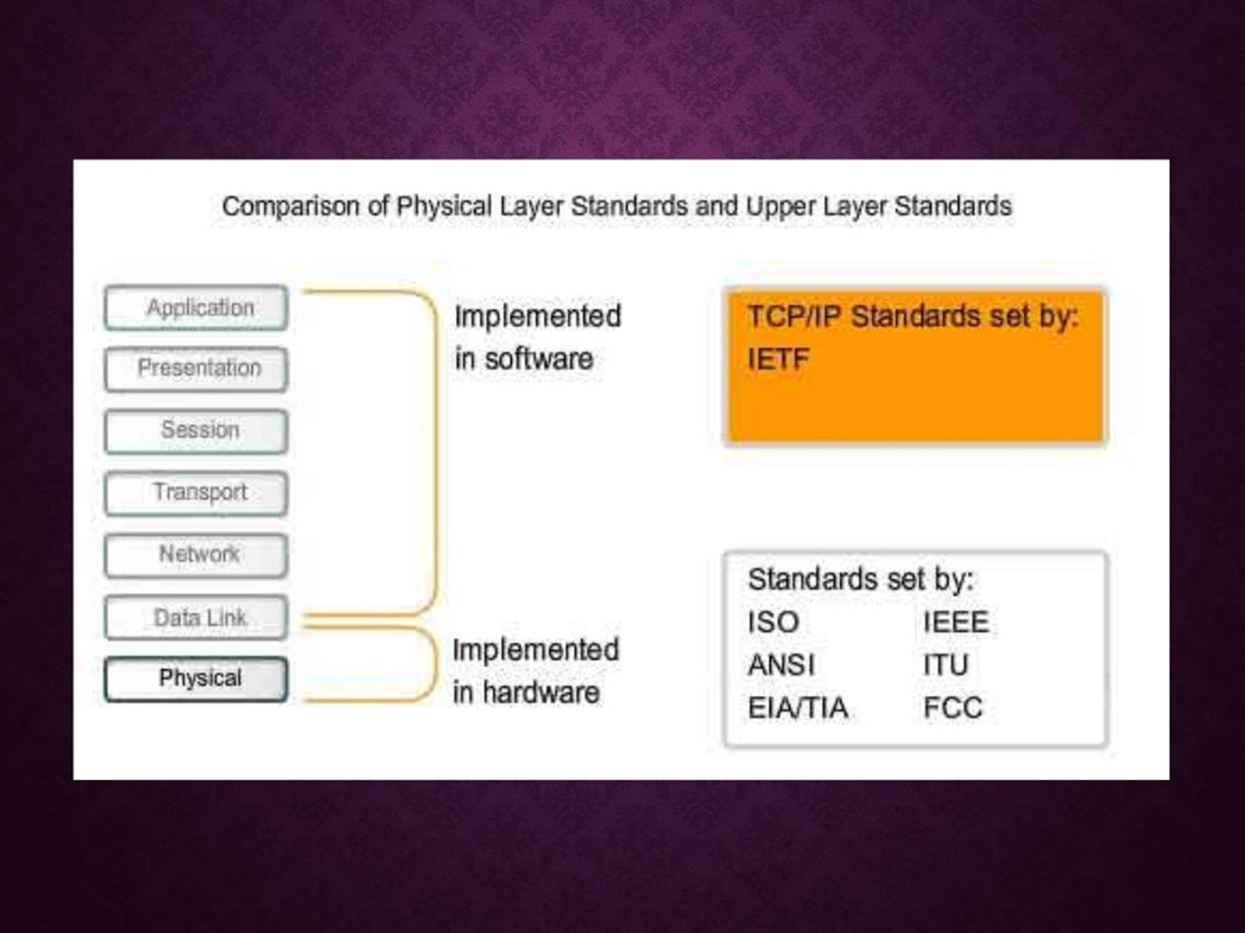
Cntd…

Slide 10
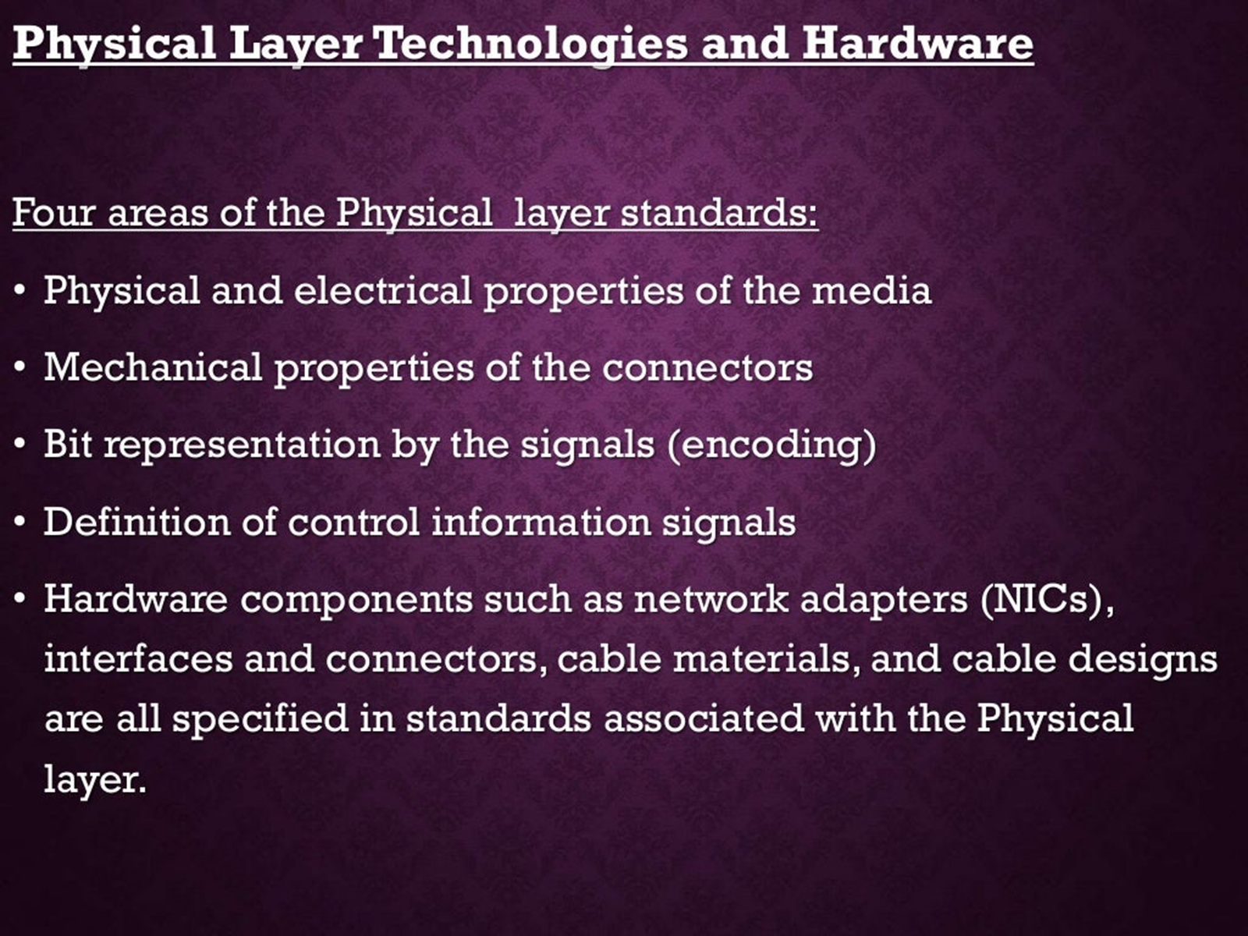
Cntd…

Slide 11
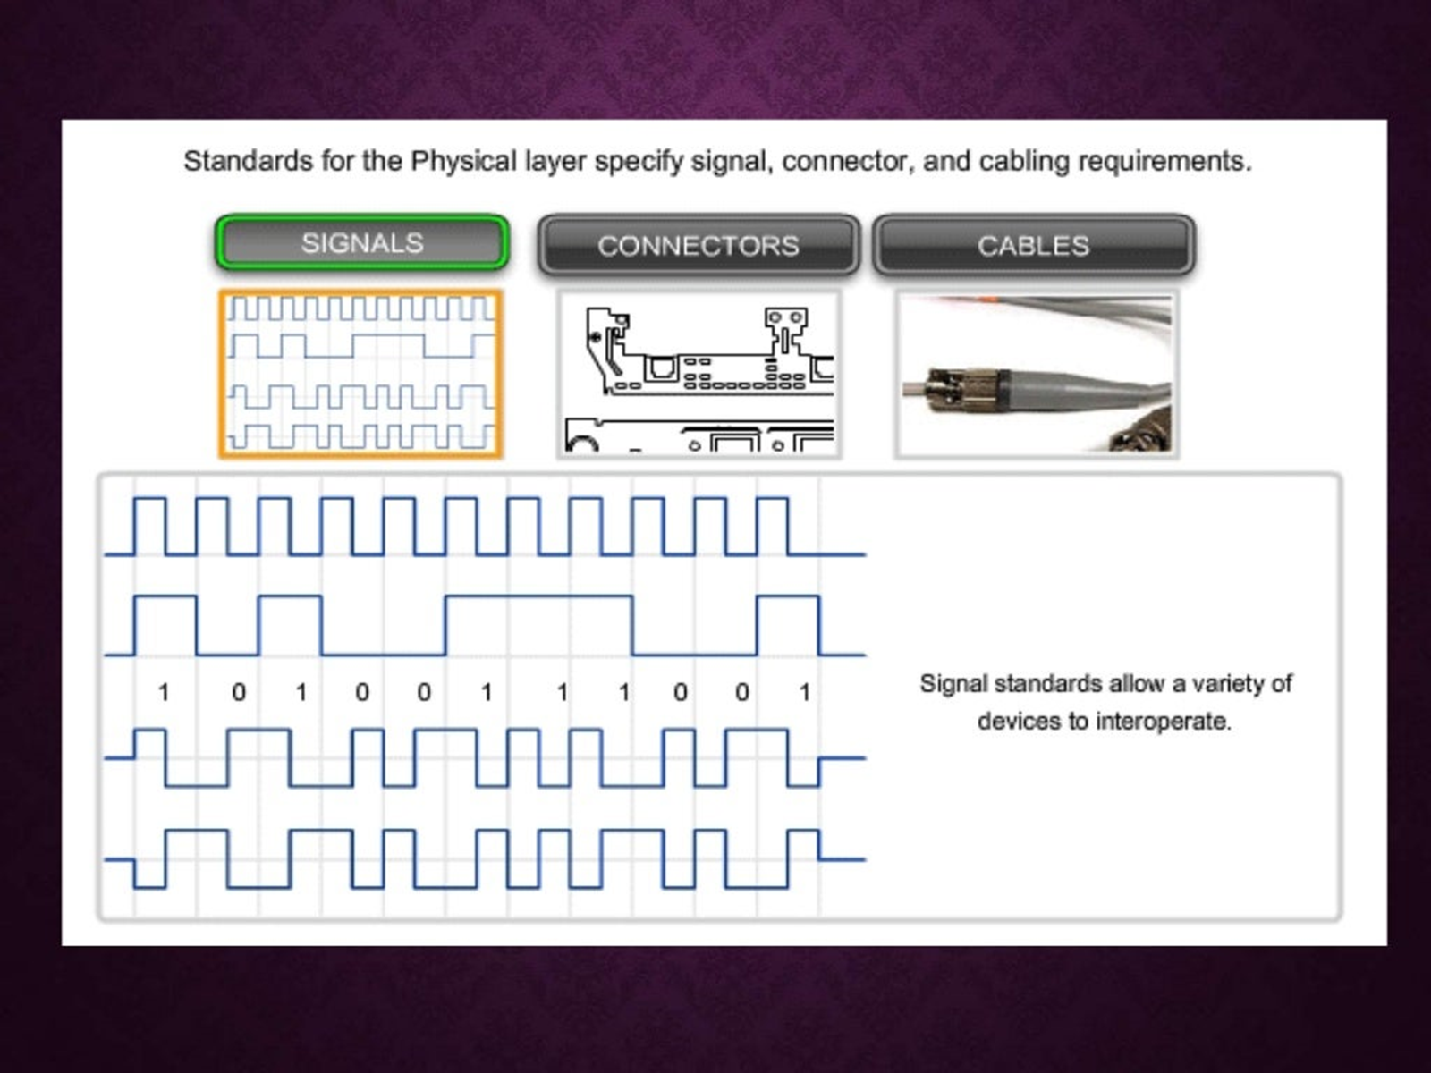
Cntd…

Slide 12
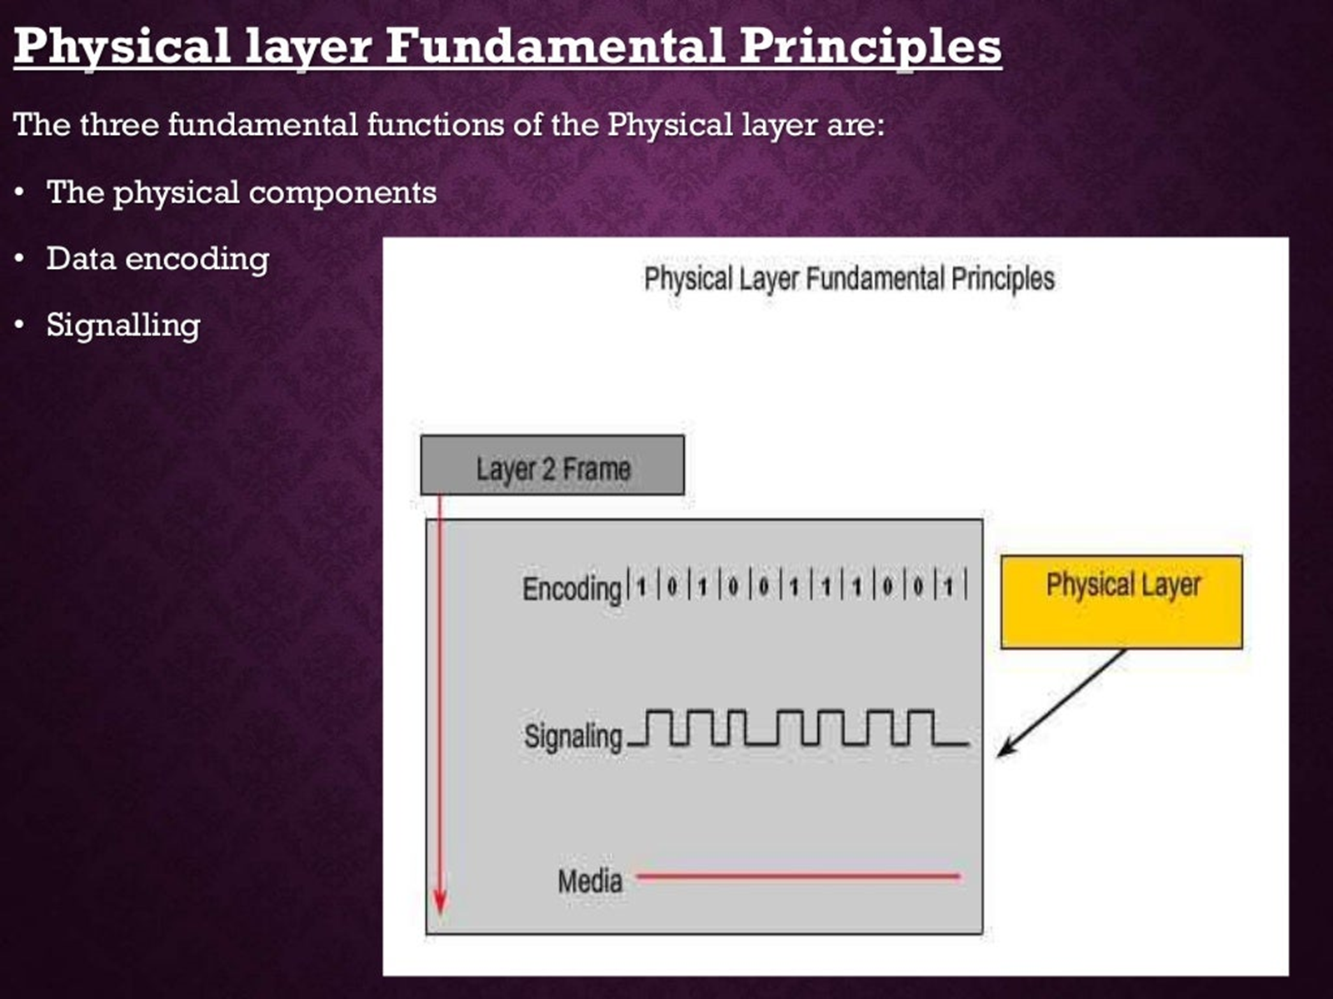
Cntd…

Slide 13
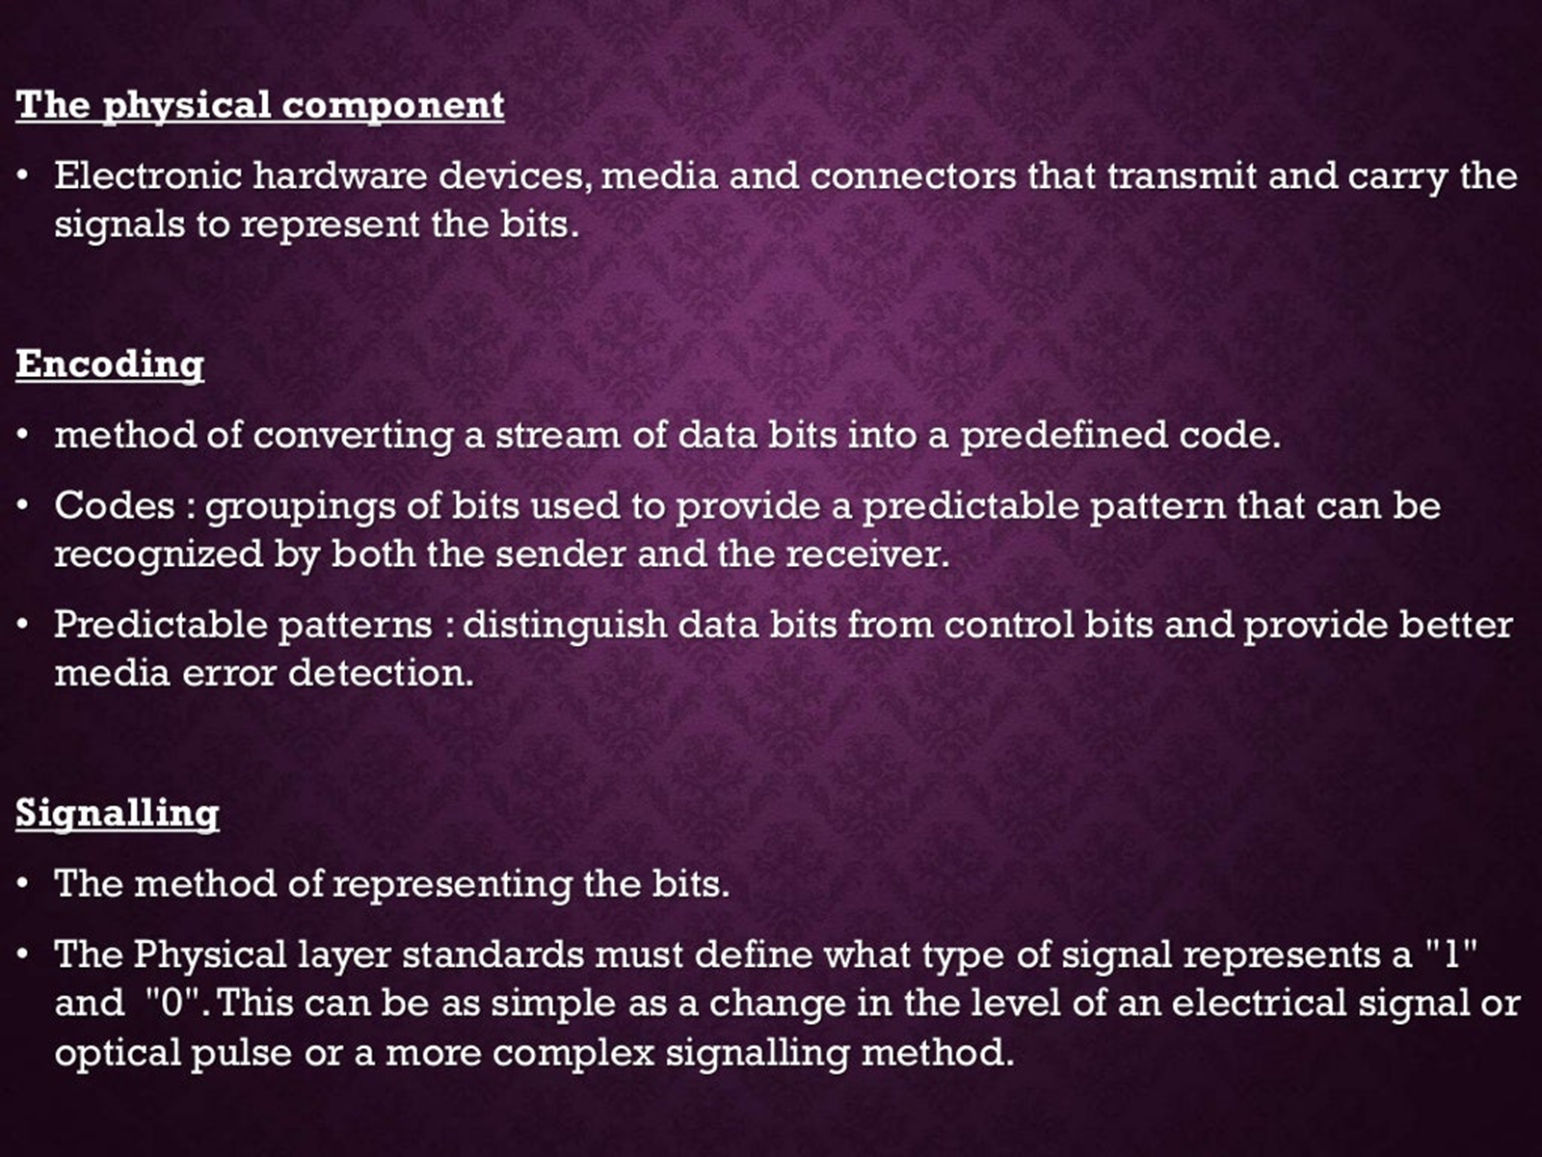
Cntd…

Slide 14
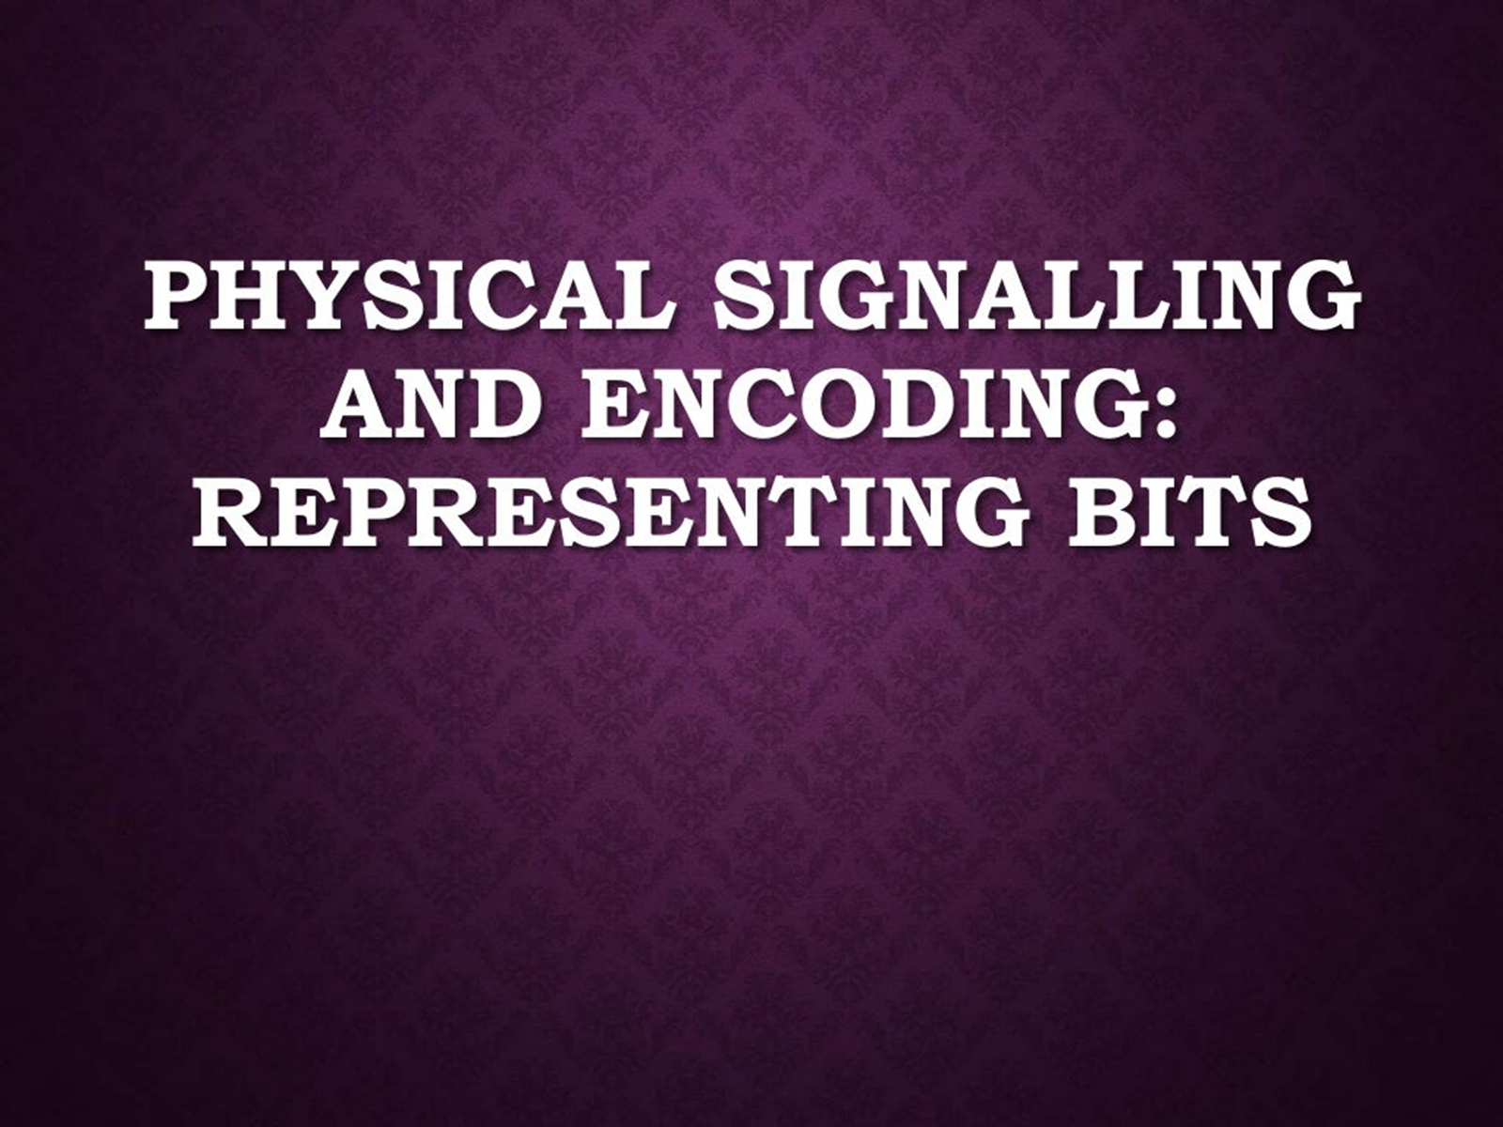
Cntd…

Slide 15
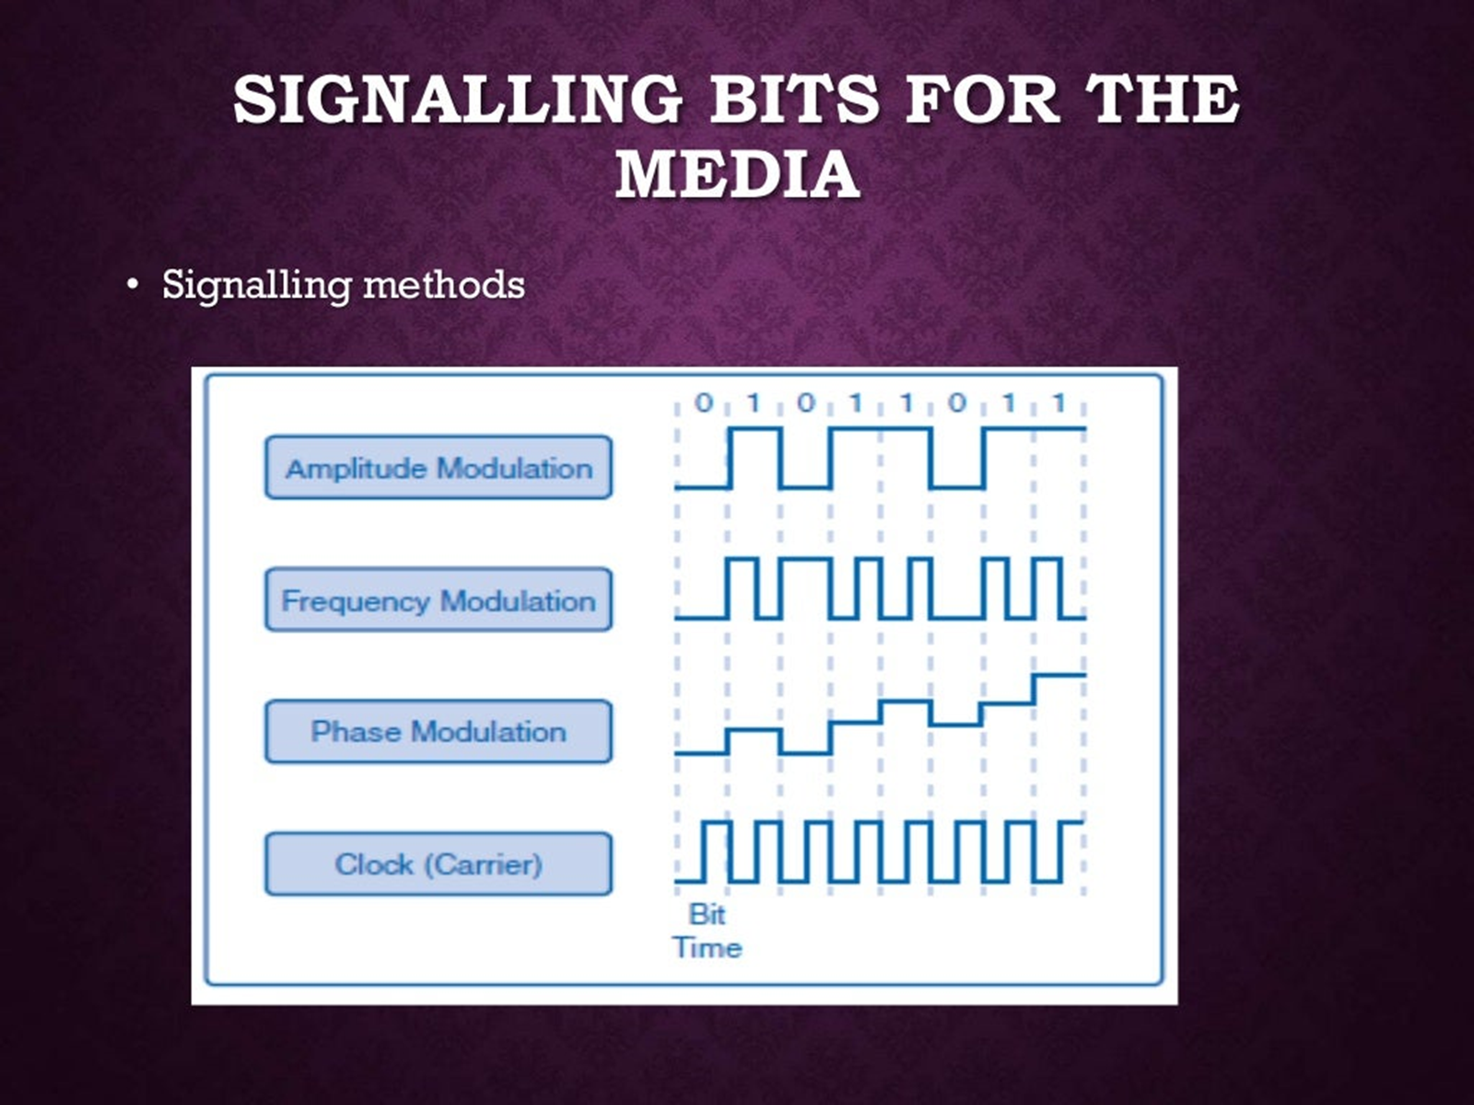
Cntd…

Slide 16
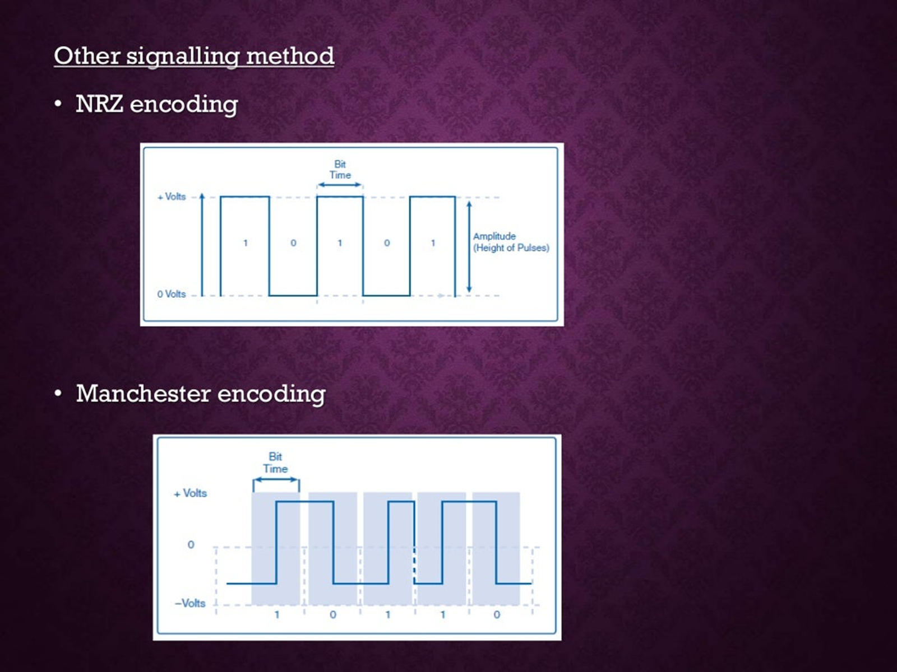
Cntd…

Slide 17
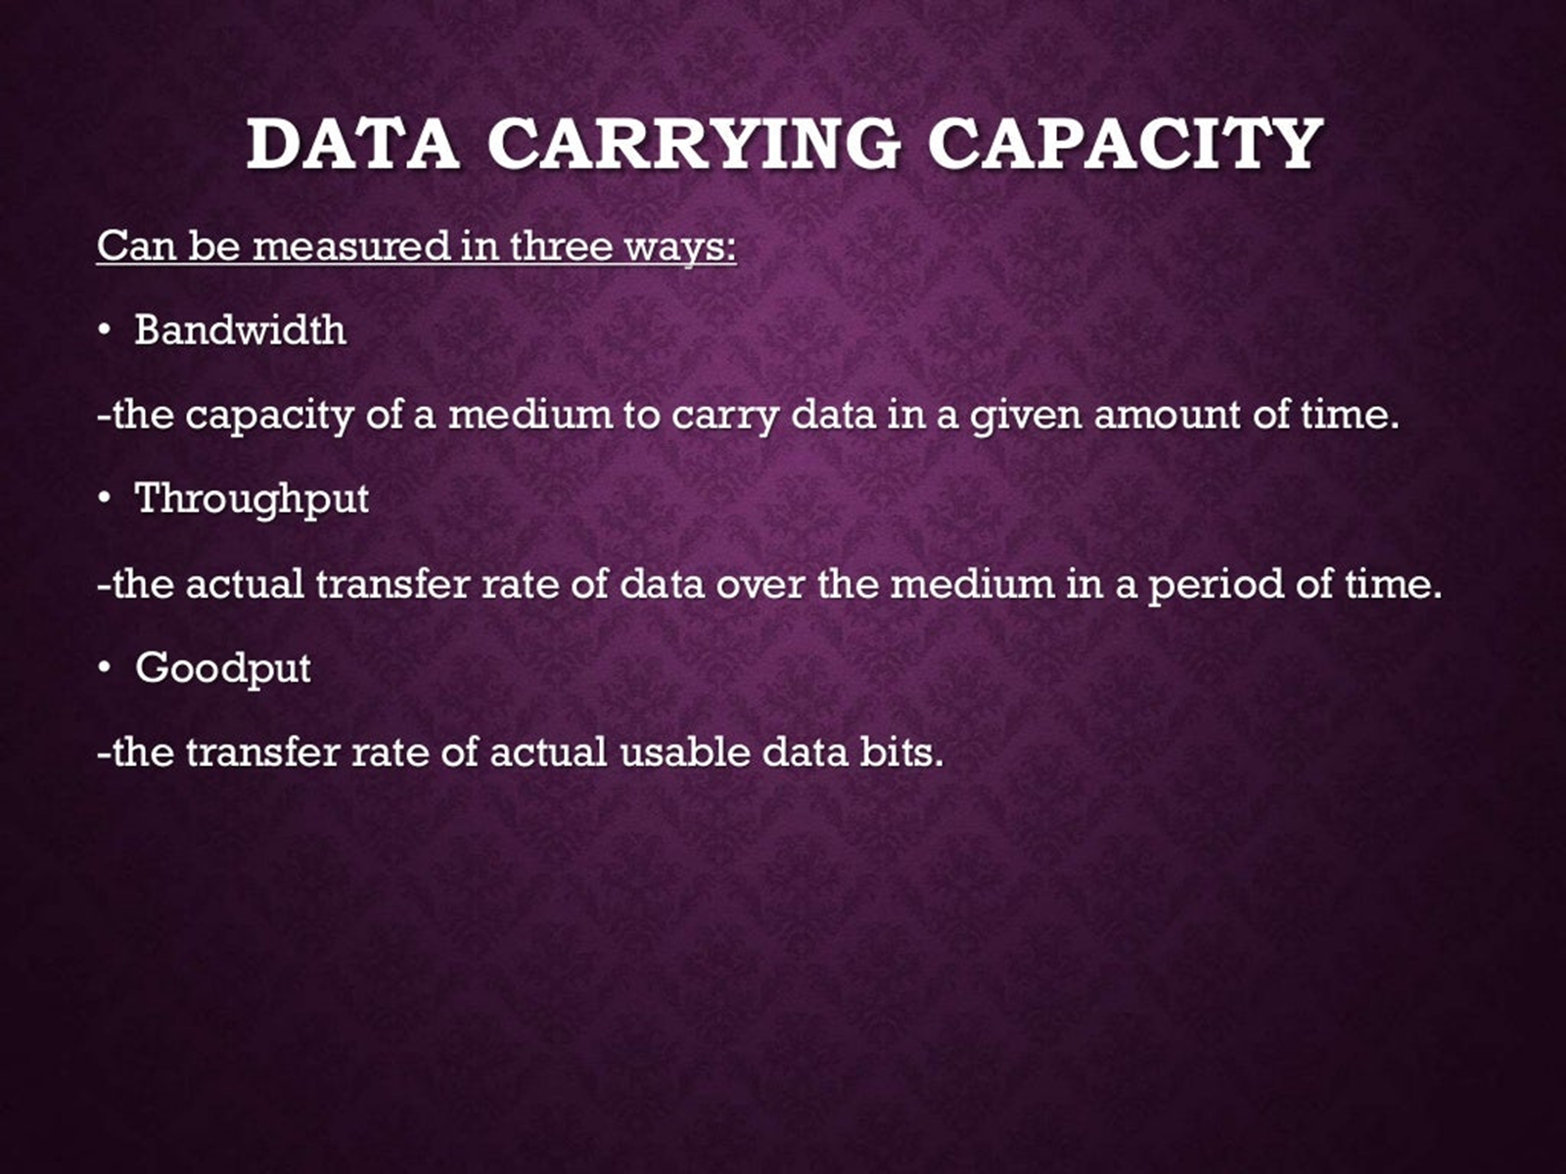
Cntd…

Slide 18
  Data Link Layer

Slide 19
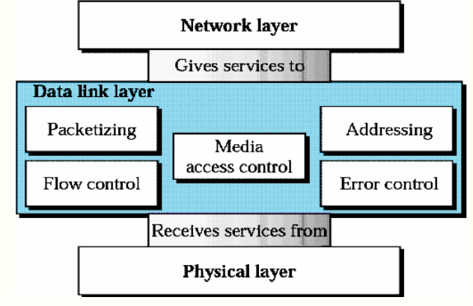
Introduction
  The data link layer is responsible for carrying a frame from one hop (computer or router) to the next hop; i.e., it has local responsibility unlike the network layer
  Position of the data link layer

Slide 20
Data Link Layer Protocol Services in Brief
  Packetizing (framing or encapsulation)
  Encapsulate datagram/packet into frame, adding header and trailer
  Addressing
  MAC (Media Access Control) addresses are used in frame headers to identify source and destination; different from IP addresses!
  Error control
  Reliable delivery between adjacent nodes (error detection and correction)
  Error detection
  Errors can be caused by signal attenuation, noise, etc.
  The receiver detects the presence of errors, drops the frame and waits for retransmission

Slide 21
Cntd…
  Error Correction
  The receiver identifies and corrects bit error(s) without resorting to retransmission
  Seldom used on low bit-error link (fiber, some twisted pair)
  Used on wireless links: high error rates
  Flow Control
  Pacing between adjacent sending and receiving nodes
  Media Access (Link) Control
  Channel access if medium is shared
  Examples of link layer protocols: Ethernet, 802.11 wireless LAN, token ring, and PPP
  A datagram may be carried by different protocols on the different links in the path, e.g., Ethernet on first link, frame relay on intermediate links, 802.11 on last link

Slide 22
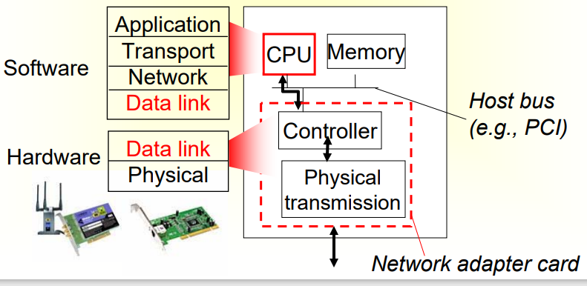
Where is the link layer implemented?
  It exists in each and every host (end systems and routers)
  It is implemented in adaptor (network interface card - NIC)
  The adaptor
    Implements data link and physical layers
    Attaches into host’s system bus
    e.g., Ethernet card, 802.11 card
  Implemented as a combination of hardware and software

Slide 23
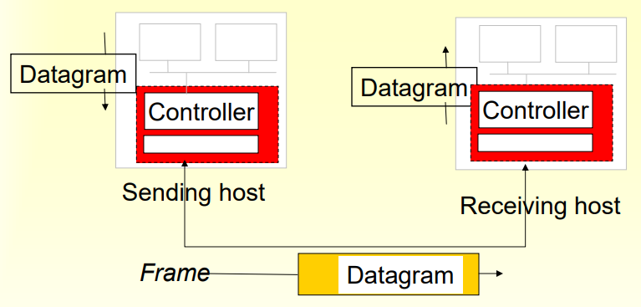
Adaptors Communicating
  Receiving side
  Looks for errors, flow control, etc.
  Extracts datagram and passes to upper layer
  Sending side
  Encapsulates datagram into frame
  Adds error checking bits, flow control, etc.

Slide 24
Data Link Control and Protocols
  For reliable data delivery across the link, the data link layer has two most important responsibilities: flow control and error control, collectively known as data link control
  Error Control
  Networks must be able to transfer data from one device to another with complete accuracy - our wish
  Data can be corrupted during transmission - many factors exist - like transmission impairments
  Hence, reliable systems must have a mechanism for detecting and correcting error
  Error control refers to both error detection and error correction
  In the data link layer, error control refers primarily to methods of error detection and retransmission
  ▪ Anytime an error is detected, specified frames are retransmitted; this process is called Automatic Repeat Request (ARQ)

Slide 25
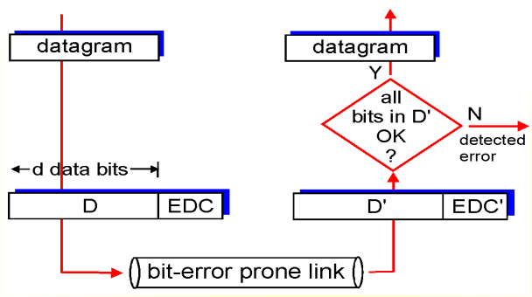
Cntd…
  EDC = Error Detection and Correction bits (redundancy)
  D = Data protected by error checking, may include header fields
  Error detection is not 100% reliable!
    The protocol may miss some errors, but rarely
    A larger EDC field yields better detection and correction but larger overhead

Slide 26
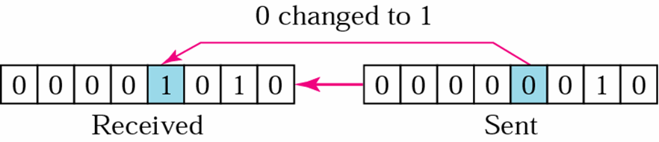
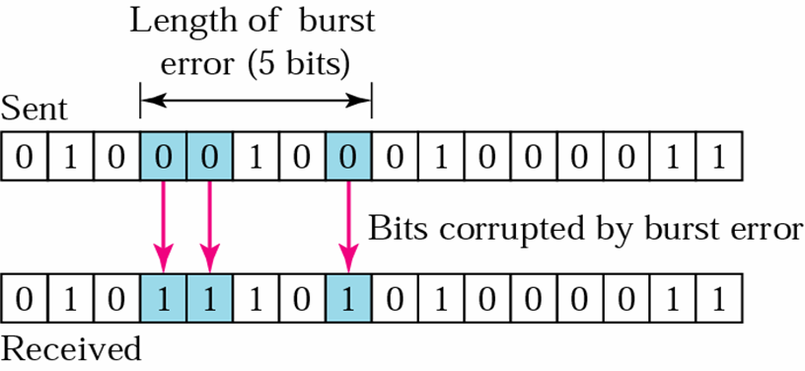
Cntd…
Two types of errors: single-bit error and burst error
  Single-bit error: only one bit in a data unit (byte, character, packet, ...) has changed; less likely to occur in serial transmission (since noise normally lasts longer than the transmission time of 1 bit, e.g., 1 microsecond if speed is 1 Mbps), but most likely to occur in parallel transmission
  Burst error: 2 or more bits in the data unit have changed; most likely to occur in serial transmissions

Slide 27
Cntd…
For error detection and correction, include redundant error- detection (and correction) codes with the data
  Two possibilities
    Forward error correction: include enough redundant information (called error-correcting codes) to enable the receiver to deduce what the transmitted data must have been; the hamming code is used to detect and correct errors.
    Error correction by retransmission: include only enough redundant information (called error-detecting codes) to allow the receiver to deduce that an error occurred, but not which error; when an error is detected, the sender will retransmit the entire data unit

Slide 28
Cntd…
Two types of error-detecting codes: parity check and cyclic redundancy check (a third one, called checksum, also exists.
  Parity check: most common and simple; two varieties
    Simple parity check: a redundant bit, called a parity bit, is added to every data unit so that the total number of 1s in the unit (including the parity bit) becomes even (or odd for odd- parity)
      This method can detect all single-bit errors; it can detect burst errors only if the total number of errors in each data unit is odd
    Two-dimensional parity checks: a block of bits is organized in a table (rows and columns)

Slide 29
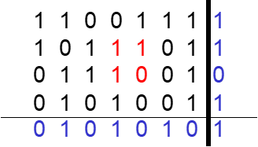
Cntd…
Original 1100111 1011101 0111001 0101001
  After parity bits are calculated and attached
Column parities More overhead
Data and parity bits when transmitted
11001111 10111011 01110010 01010011 01010101
Can detect most errors, If 2 bits in one data unit are damaged and two bits in exactly the same positions in another data unit are also damaged, the checker will not detect an error.
Row parities

Slide 30
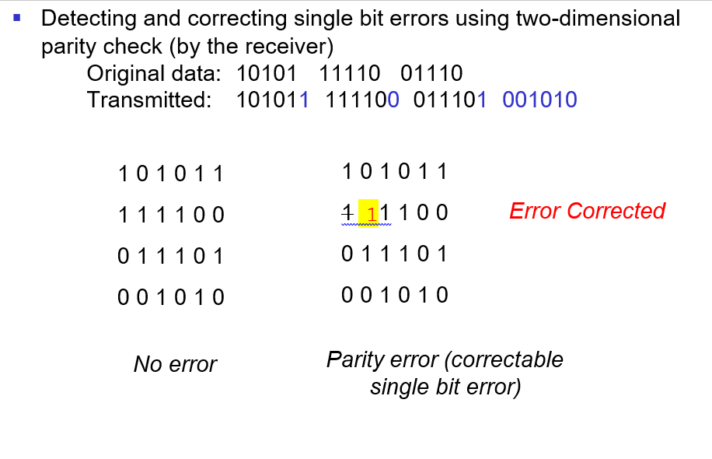
Cntd…
0

Slide 31
Cntd…
Cyclic redundancy check (CRC): is based on binary division
  The CRC is appended to the end of a data unit so that the resulting data unit becomes exactly divisible by a second, predetermined binary number
2.2.2. Flow control
    Flow control: refers to a set of procedures used to restrict the amount of data that the sender can send before receiving an acknowledgement
    Congestion control: refers to a mechanism used by the network to limit congestion
    Flow control and congestion control are not really separable, and we will refer to both as flow control
    Limiting factors: speed of the receiver (to process incoming data), amount of memory (buffer) to store the incoming data before processed, and network capacity

Slide 32
Cntd…
Rate of processing is normally slower than rate of transmission
    The receiver must be able to inform the sender to temporarily halt transmission until it is ready to receive more
If no flow control, when overload occurs
  Queues build up
  Packets are discarded
  Sources retransmit packets
  Congestion increases è network instability
Flow control prevents network instability by keeping packets waiting outside the network rather than in queues inside the network
  i.e., it avoids wasting network resources
Flow and Error Control Mechanisms (three methods)
A Utopian Simplex Protocol
  Simplex transmission: from sender to receiver

Slide 33
Cntd…
Processing time is ignored; the receiver is assumed to process the received data infinitely quickly
Infinite buffer space is assumed to be available on all nodes
Communication channel is assumed to be free of error
Stop-And-Wait ARQ
  Protocols in which the sender sends one frame and then waits for an acknowledgement before proceeding are called stop- and-wait
  Data traffic is simplex, but frames travel in both directions; hence a half-duplex physical channel suffices
  It assumes that
    Receiver has a finite buffer space and finite processing speed, i.e., flow control is required
    Communication channel is free of error
This protocol fails if ack frames by the receiver do not arrive or are late

Slide 34
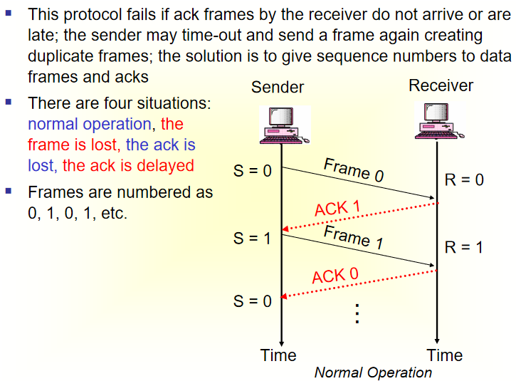
Cntd….

Slide 35
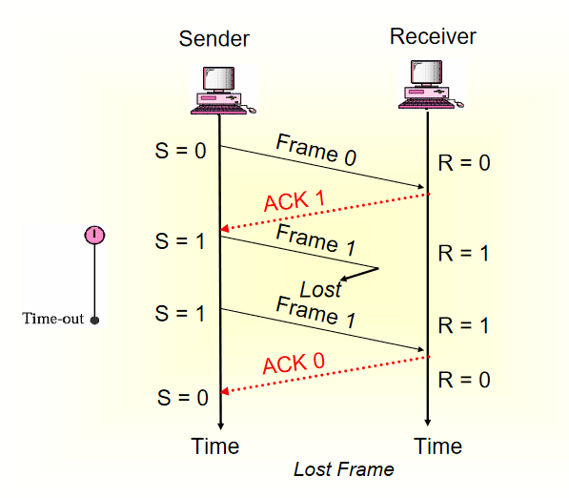
cntd,…

Slide 36
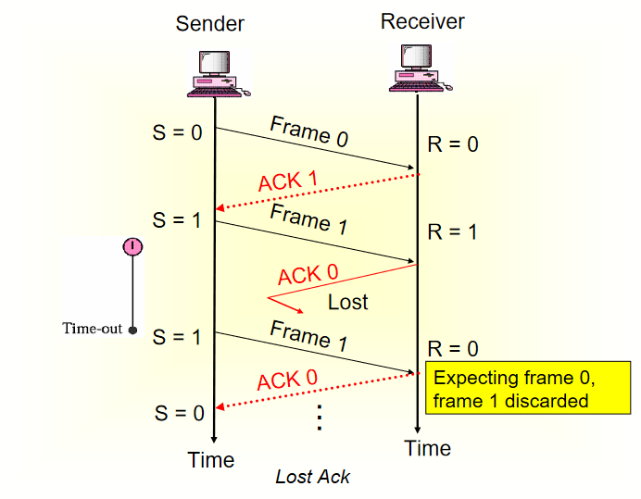
Cntd…

Slide 37
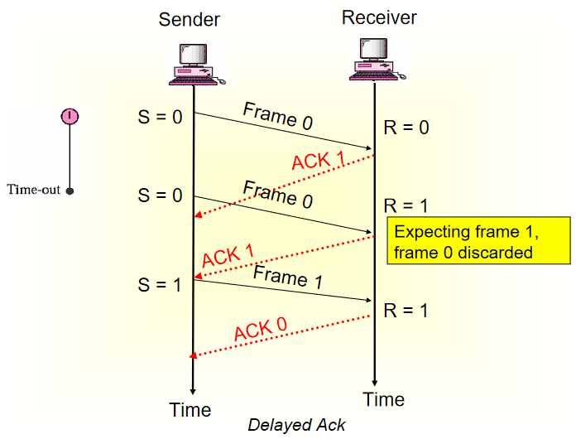
Cntd…

Slide 38
Cntd…
3. Sliding Window Protocols
Stop-and-wait ARQ is not efficient; there is only one frame that is sent
Can we transmit multiple frames while waiting for an ack?
Use full-duplex transmission
Two protocols: Go-Back-N ARQ and Selective Repeat ARQ
Both methods require frames to be numbered
Sequence numbers
  Frames from a sending station are numbered sequentially from 0 to 2m-1, where m is the number of bits of the sequence number in the frame header, e.g., let m = 3, then frames can be numbered as
  0, 1, 2, 3 ,4, 5, 6, 7, 0, 1, 2, 3, 4, 5, 6, 7, 0, 1, …

Slide 39
Cntd…
A. Go-Back-N-ARQ
The sender and receiver have sliding windows
The sender’s window is of fixed size and is at most 2m-1; but other protocols such as TCP allow variable size windows (see later in the transport layer); it holds frames sent but not acknowledged
The receiver’s window is of size 1
The sender sets a timer for each frame sent; the receiver has no timer
The receiver sends positive acknowledgement if a frame has arrived safe and in order
If a frame is damaged or out of order, the receiver discards it and keeps silent and discards all subsequent frames; this causes the timer of the sender to expire and goes back and resends all frames, beginning from the one with the expired timer.
The receiver does not need to acknowledge Individually frames

Slide 40
Cntd…
B. Selective Repeat ARQ
In Go-Back-N ARQ, the task of the receiver is simplified; no need to buffer out-of-order frames; they are simply discarded
Go-Back-N ARQ is inefficient for a noisy link that has a high probability of damage resulting in the resending of multiple frames
For a noisy link, use Selective Repeat ARQ that requires resending only the damaged frame
Selective Repeat ARQ defines a negative ack (NAK) that reports the sequence number of a damaged frame before the timer expires
The sender and receiver windows are both at most half of 2m
The receiver's window defines the range of acceptable sequence numbers, i.e., frames may arrive out of order

Slide 41
Cntd…
Examples of data link protocols
  HDLC - High-level Data Link Control
    An ISO standard
    A protocol designed to support both half-duplex and full- duplex communication over point-to-point and multipoint links that implements the ARQ mechanisms
  PPP - Point-to-Point Protocol
    Used in the Internet for router-to-router and home user-to-ISP traffic, e.g., dialup link, ISDN line
    One sender, one receiver, one link: easier than broadcast link
      No Media Access Control
      No need for explicit MAC addressing
    No error correction/recovery, no flow control, out of order delivery OK; error recovery, flow control, and data re-ordering are all transferred to higher layers!

Slide 42
Cntd…
3.2. Media (Multiple) Access Control
Types of connections or link-layer channels or links
  Point-to-point: provides a dedicated link between two devices (i.e., only one sender and only one receiver and hence no collision), e.g., between two routers or between a residential dial-up modem and an ISP router; PPP is used
  Multipoint (or broadcast channel): more than two devices share a single link (spatially - simultaneously - or temporally by taking turns), e.g., Ethernet LANs, wireless LANs (also known as WiFi), satellite networks, and hybrid fiber-coaxial cable (HFC) access networks
Multiple Access Protocols
  The problem of controlling the access to the medium is similar to the rules of speaking in an assembly (the right to speak is upheld; two people do not speak at the same time; do not interrupt each other; do not monopolize the discussion; ...)

Slide 43
Cntd…
Three categories of multiple access protocols
  Random Access Protocols - try your best like taxis do
    MA - Multiple Access
    CSMA - Carrier Sense MA
    CSMA/CD - CSMA with Collision Detection
    CSMA/CA - CSMA with Collision Avoidance
  Controlled-Access (Taking-turns) Protocols - get permission
    Reservation
    Polling
    Token Passing
  Channelization (or Channel Partitioning) Protocols - simultaneous use
    FDMA - Frequency-Division MA
    TDMA - Time-Division MA
    CDMA - Code-Division MA (to be covered in Chapter 4 - Wireless and Mobile Networks)

Slide 44
Cntd…
Random Access Protocols
  Each station has the right to use the medium without being controlled by any other station
  Channel is not divided; hence collision may occur if more than one station tries to send
  We need a procedure to answer the following questions
    When can a station access the medium?
    What can the station do if the medium is busy?
    How can the station determine the success or failure of the transmission?
    What can the station do if there is an access conflict?
MA - Multiple Access
  ALOHA is the earliest RA method developed at the University of Hawaii in the early 1970s
  Originally designed to be used on a radio LAN with a data rate of 9600 bps. Aloha (in Hawaiian language) means hello and goodbye

Slide 45
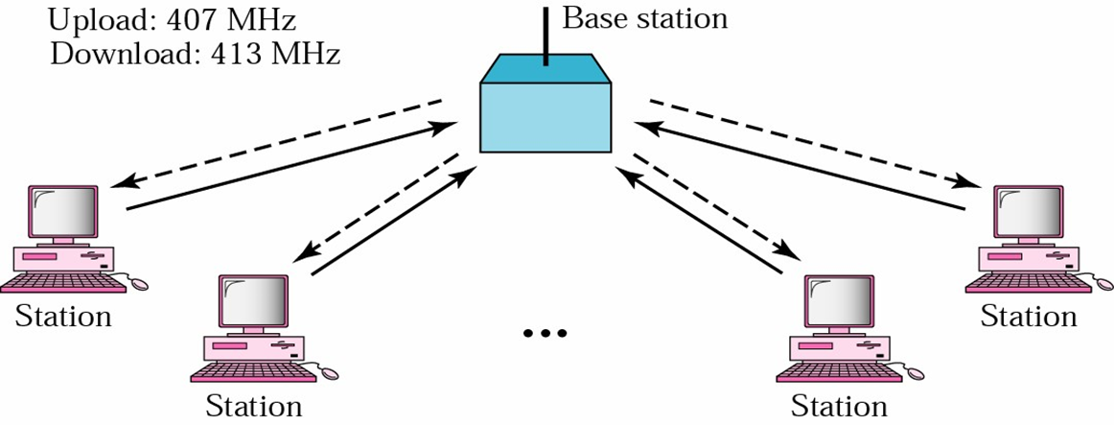
Cntd…
A base station serves as a central controller; each station sends a frame to the base station with an uplink frequency of 407 MHz (the solid line in the figure); the base station sends it to the receiver using a downlink frequency of 413 MHz (the dashed line in the figure)

Slide 46
Cntd…
Potential collisions exist (on the upload link); so wait for acknowledgement; if none arrives wait a period of time (2 times the maximum propagation delay), send again if back off (waiting) limit did not reach; the time it waits increases from one trial to the next
Versions
  Pure ALOHA (the method discussed)
  Slotted ALOHA
    Time is divided into discrete intervals of one frame duration
    The nodes are synchronized so that each node knows when a slot begins
    Transmitting a frame is allowed only at the beginning of a slot
    Still collision is possible; collided packets are retransmitted after a random delay

Slide 47
Cntd…
CSMA - Carrier Sense MA - polite version of ALOHA
  To minimize the chance of collision, each station first listens to the medium before sending; “listen before talk”; in the network world this is called carrier sensing
  If the channel is busy, it waits until it is idle
  Otherwise it transmits; if a collision occurs, it waits a random amount of time and starts listening again
  The chance of collision is minimized
    But may still occur because of the propagation delay (a station doesn’t know if another one has just started transmitting) or
    If two or more stations start transmitting at the same time
  CSMA was never implemented

Slide 48
Cntd…
iii. CSMA/CD - CSMA with Collision Detection
  Adds a procedure to handle a collision
  A transmitting station listens to the channel while it is transmitting (collision detection); if a collision is detected and to reduce the probability of collision the second time, the sender waits; it has to back off
  It waits a little the first time, more if a collision occurs again, much more if it happens a third time, and so on; finally it gives up
  In the exponential backoff method, it waits an amount of time between 0 and (2 power N x maximum_propagation_time), where N is the number of attempted transmissions
  Used in traditional Ethernet

Slide 49
Cntd…
iv. CSMA/CA - CSMA with Collision Avoidance
  Tries to avoid collision
  After it finds the line idle, it waits an IFG (interframe gap) amount of time; it then waits another random amount of time; after that it sends the frame and sets a timer;
  If it receives an ack before the timer expires, the transmission is successful; otherwise something is wrong (the frame or the ack is lost); waits for a backoff amount of time and re-senses the line
  Used in wireless LANs

Slide 50
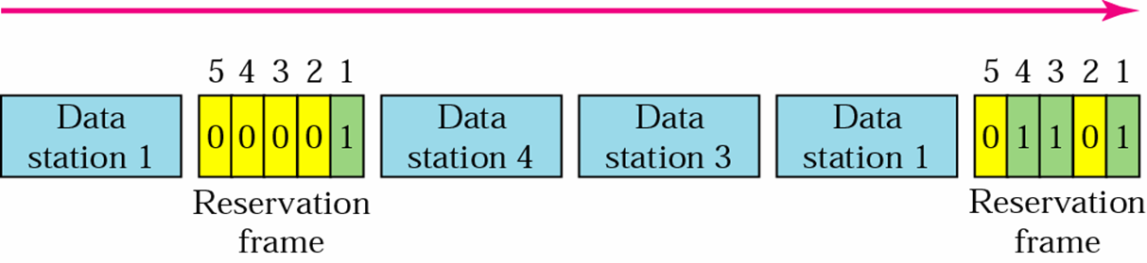
Cntd…
2. Controlled- Access (Taking-Turns) Protocols
  The stations consult one another to find which station has the right to send; a station can not send unless it has been authorized by other stations
Reservation
  A station needs to make a reservation before sending data
  Time is divided into intervals; in each interval, a reservation frame precedes the data frames sent in that interval; if there are N stations in the system, there are exactly N reservation mini slots in the reservation frame

Slide 51
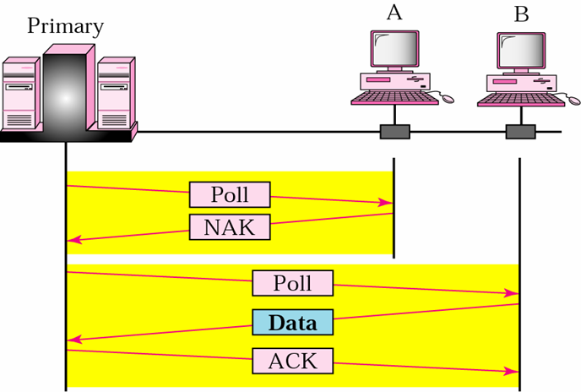
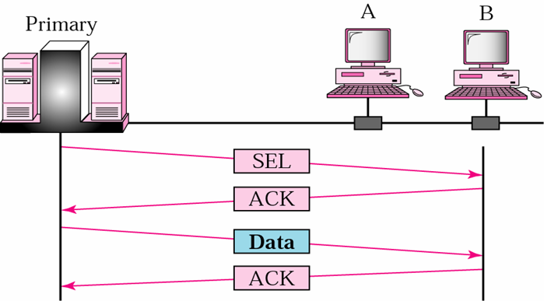
Cntd…
ii. Polling
One device is designated as a primary (master) station and the other stations are secondary stations
The primary asks the secondaries if they have data to send (polling) in a round-robin fashion; when it has data to be sent, the primary tells the secondary to get ready to receive (selecting)
This protocol eliminates collisions
But it introduces a polling delay and a single point of failure - if the primary fails

Slide 52
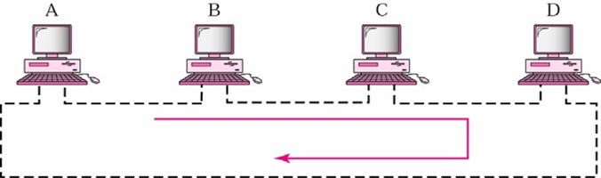
Cntd…
iii. Token Passing
  A station is authorized to send data when it receives a special frame called a token
  The stations are arranged around a ring (each station has a predecessor and a successor)
  A token circulates around the ring when no data is transmitted
  Token: a bit sequence
    Free token: 01111110
    Busy token: 01111111
  When a node wants to transmit
    Waits for a free token
    Removes the token from ring (replaces it with a busy token)
    Transmits the message
    When done transmitting, replaces a free token on the ring

Slide 53
Cntd…
Token failures: tokens can be created or destroyed by noise
Distributed solution
  Nodes are allowed to recognize the loss of a token and create a new token
  Collision occurs when two or more nodes create a new token at the same time è need collision resolution algorithms
Node failures: since each node must relay all incoming data, the failure of a single node will disrupt the operation of the ring
E.g., FDDI - Fiber Distributed Data Interface - is a 100 Mbps fiber optic token ring LAN standard,
It is also used for MANs

Slide 54
Cntd…
3. Channelization Protocols
  The available bandwidth of a link is shared in time, frequency, or through code, between different stations/nodes
FDMA - Frequency-Division MA
  The available bandwidth is divided into channels; the R bps channel is divided into different frequencies, each with a bandwidth of R/N, where N is the number of stations
  Each station uses its allocated frequency band to send its data; each frequency band is reserved for a specific station (it belongs to it all the time)

Slide 55
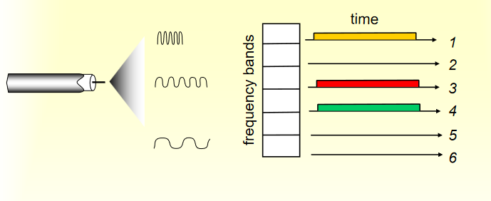
Cntd…
  Example: 6-station LAN; 1, 3, 4 have packets, frequency bands 2, 5, 6 are idle

Slide 56
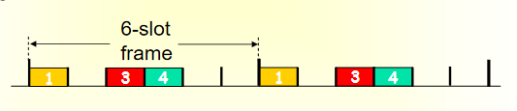
Cntd…
ii. TDMA- Time-Division MA
  The entire bandwidth is just one channel; the stations share the capacity of the channel in time; time is divided into time frames and each time frame is further divided into N time slots; each station is allocated a time slot during which it can send data
  Time slots are chosen so that a single frame can be transmitted during a time slot
  e.g., 6-station LAN; 1, 3, 4 have packets, slots 2, 5, 6 are idle

Slide 57
Cntd…
Advantages of TDM and FDM
  They eliminate collisions
  They are fair - each station gets a dedicated transmission rate of R/N bps
Disadvantages of TDM and FDM
  A node is limited to an average rate of R/N bps even when it is the only node with frames to send; unused transmission time in frequency bands or time slots go idle

Slide 58
Cntd…
2.4. Addressing
Network-layer addresses are 32-bit IP addresses and are used to send a datagram/packet to a destination IP subnet - see later
MAC (or LAN or Physical or Ethernet) address
  The data link layer hardware does not understand IP addresses to send a frame from one node to the next
  A NIC provides a 6-byte physical address in hexadecimal; there are 248 possible LAN addresses; a NIC’s address is permanent
- the address is burned into its ROM during manufacturing, also sometimes software settable
e.g., 06-01-02-01-2C-4B
MAC address allocation is administered by IEEE
A NIC manufacturer buys a portion of the MAC address space (to assure uniqueness)
MAC is a flat address ➜ portability
  One can move a LAN card from one LAN to another
IP is a hierarchical address ➜ NOT portable

Slide 59
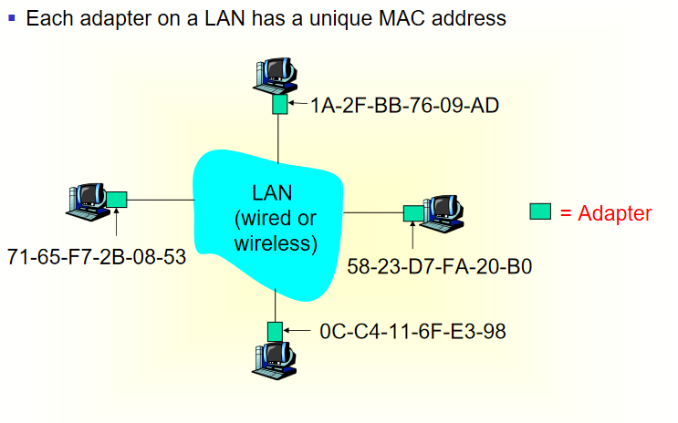
Cntd…

Slide 60
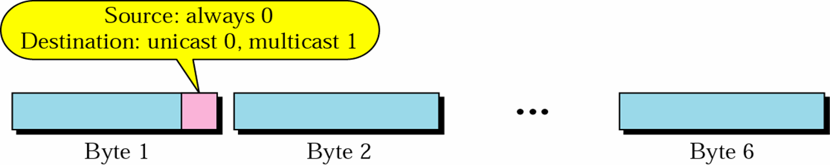
Cntd…
Unicast, Multicast, and Broadcast addresses: a source address is always a unicast address; the destination address can be unicast (only one destination), multicast (multiple destinations), or broadcast (all the stations on the network) 48 1s - FF-FF-FF-FF-FF-FF in hexadecimal

Slide 61
Cntd…
Address Resolution
  A MAC address is a local address
  Delivery of a packet to a host or a router requires two levels of addressing: IP and MAC
A mapping of IP addresses to MAC addresses is required (in general changing one type of address to another is called address resolution)
  Two types of mapping: static and dynamic
  Static Mapping
    Create a table that associates an IP address with a MAC address, stored in each machine on a network
    Network performance is degraded to update the table periodically because of the following reasons
      A machine could change its network card
      In some LANs such as LocalTalk of Apple, the MAC address changes every time the computer is turned on
      A mobile computer can move from one physical network

Slide 62
Cntd…
Dynamic Mapping
  Each time a machine knows one of the two addresses, it can use a protocol to find the other one
  Two protocols: Address Resolution Protocol (ARP) maps an IP address to a MAC address and Dynamic Host Configuration Protocol (DHCP) maps a MAC address to an IP address – to be discussed later in the Network Layer
  Devices at the Link and Network Layers(reading Assignment)

Slide 63
  End of chapter Four
  Any question??

